Slide 1
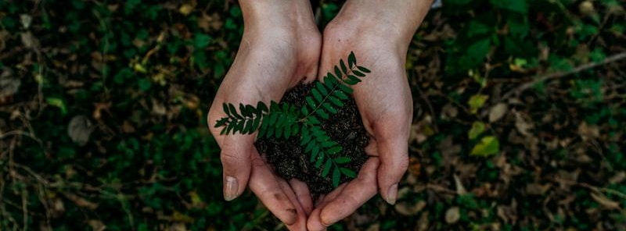
SCRAPLINK
SMART SCRAP PICKUP
Schedule. Pickup. Impact.

Slide 2
PROBLEM STATEMENT
The waste collection gap
Many households generate recyclable waste such as paper, plastic, and metal, but they do not have a reliable and convenient way to schedule scrap pickups.
Kabadiwalas usually follow fixed routes and often visit homes when scrap is not ready, which leads to wasted time, fuel, and effort.
Due to the absence of proper tracking and data, it is difficult to measure the environmental impact of recycling activities and improve waste collection efficiency.

Slide 3
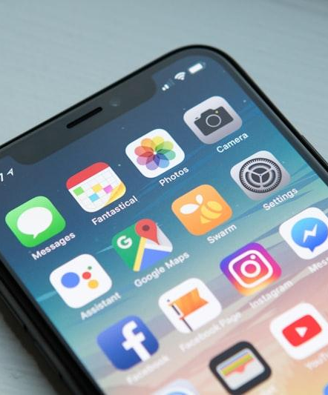
PROPOSED
SOLUTION
ScrapLink mobile application
For Households
Schedule pickups, select materials, receive reminders, and track recycling impact.
For Kabadiwalas
Receive requests, plan routes efficiently, track earnings, and manage customers.
For the Environment
A digital bridge connecting communities to sustainable waste management.

Slide 4
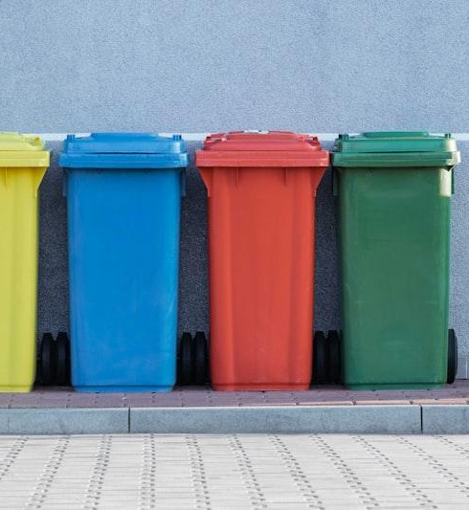
PROJECT
OBJECTIVES
Improve communication between households and kabadiwalas
Reduce unnecessary trips and fuel consumption
Increase recycling efficiency and waste collection
Provide useful data on waste collection and recycling
Support sustainable and environmentally friendly waste management
5 core objectives driving sustainable change

Slide 5
TARGET USERS
Households
Kabadiwalas
Organizations
Families and individuals who generate recyclable waste and want convenient pickup services at their doorstep.
Local scrap collectors who collect recyclable materials from homes and sell them to recycling centers for livelihood.
Municipal bodies, companies, and environmental organizations interested in improving waste management and sustainability.

Slide 6
KEY FEATURES
Built for both sides
For Households
For Kabadiwalas
Schedule scrap pickup easily using the mobile app
Select different types of recyclable materials
Choose preferred pickup date and time
Receive reminders before the pickup
Track environmental impact and recycling history
View and manage pickup requests
Plan daily routes efficiently
Track earnings and completed pickups
Maintain customer records

Slide 7
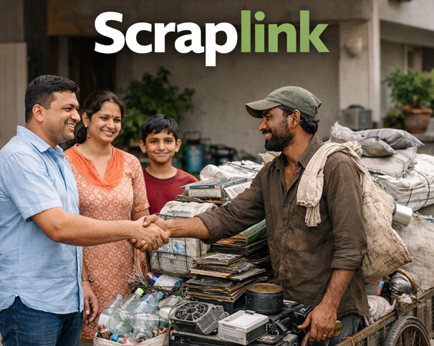
HOW THE
SYSTEM WORKS
Six simple steps from scrap to sustainability
Step 1: Household registers in the ScrapLink app
Step 2: User selects scrap materials to collect
Step 3: User schedules pickup date and time
Step 4: Kabadiwala receives the request notification
Step 5: Kabadiwala visits and collects the scrap
Step 6: System records waste and updates impact data

Slide 8
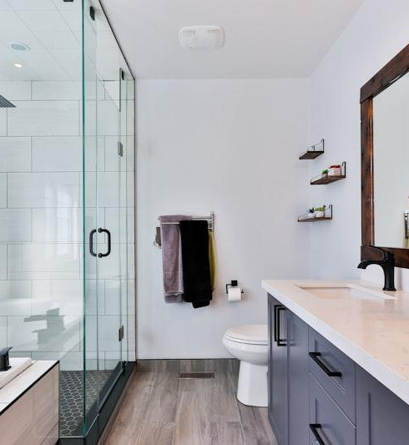
HOUSEHOLD
FEATURES
View upcoming scheduled pickups
Schedule new scrap pickups
Select materials to recycle
Track recycling progress and environmental impact
Receive notifications and reminders
Easy and convenient waste management for every home

Slide 9
PICKUP SCHEDULING
Simple and user-friendly process
1. Select the type of materials to be collected
2. Choose a suitable pickup date
3. Select a preferred time slot
4. Confirm the pickup request
This process ensures efficient and timely waste collection for every household.

Slide 10
ENVIRONMENTAL IMPACT TRACKING
Waste Collected
Pickups Completed
Carbon Reduction
Track the total amount of waste collected over time, measured in kilograms and categorized by material type.
Monitor the number of successful pickups completed, building a history of positive environmental contributions.
Measure the reduction in carbon emissions achieved through responsible recycling and sustainable waste management.

Slide 11
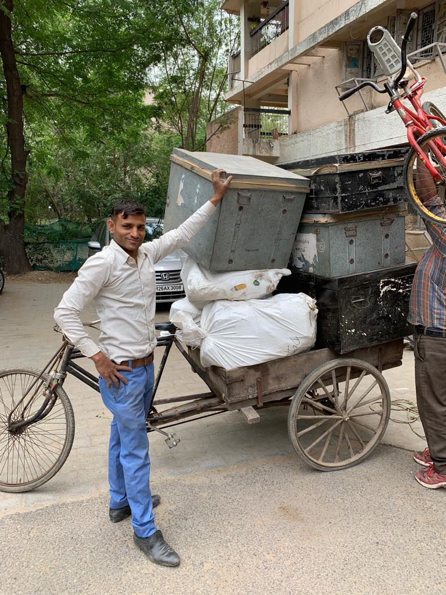
KABADIWALA
FEATURES
Manage daily work efficiently
Daily Schedule
View today's pickup schedule at a glance
Request Management
Accept or decline pickup requests instantly
Route & Earnings
Follow optimized routes and track daily earnings
Customer Records
Maintain organized customer information

Slide 12
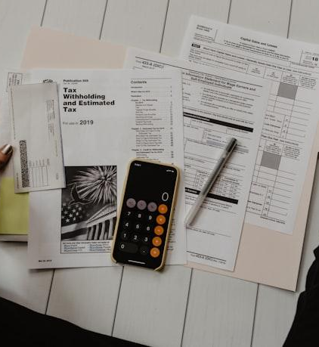
EARNINGS TRACKING
The earnings management system allows kabadiwalas to monitor their income easily.
Daily income tracking
Weekly and monthly earnings summary
Payment history records
Easy withdrawal of earnings
Transparency and financial management for collectors

Slide 13
BENEFITS OF SCRAPLINK
For Households
For Kabadiwalas
For Society
Easy and convenient scrap pickup scheduling
Cleaner homes and surroundings
Saves time and effort
Better route planning
Increased work efficiency
Higher earnings opportunities
Increased recycling rates
Reduced landfill waste
Improved environmental sustainability

Slide 14
FUTURE SCOPE
Advanced enhancements ahead
Real-time route optimization for faster pickups
Digital payment integration for secure transactions
Artificial Intelligence (AI) for demand prediction
Expansion to multiple cities across India
Integration with municipal waste management systems

Slide 15

BUILDING A CLEANER FUTURE
ScrapLink connects households and kabadiwalas through technology.
Smarter cities start with responsible waste management.

